Slide 1
How to Make a Good Presentation
Tips & Sample Slides
Daniel Naujoks
daniel.naujoks@columbia.edu @danaujoks

Slide 2
How to Make a
Good Presentation
Tips & Sample Slides
Daniel Naujoks
@danaujoks
daniel.naujoks@columbia.edu

Slide 3
Most
PowerPoint presentations
neither have power
nor a point

Slide 5
Purpose of your presentation
Enhance understanding of your presentation
Act as a tele-prompter
Hand-out for audience
Should be priority 1
Avoid when you can
Generally to be avoided (unless, e.g. you teach)

Slide 6
What’s wrong?

Slide 7
Formatting
90% of presentations are hard or impossible to read: try to have 28-30pt font size.
Make it for the people in the back of the room.
Don’t put too many points on a slide. And not too much text.
If this were a real presentation (which is it is not) this would be way too much text.
Use more slides and details to illustrate your points, rather than putting all on one “overview slide”.
Ideally you know the size of your screen before you make a presentation: How small/big should you go?

Slide 8
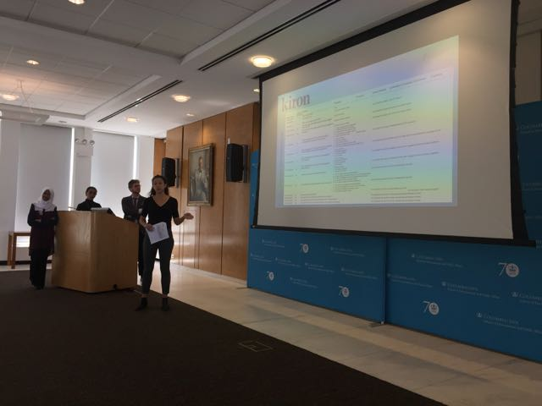

Slide 9
Formatting
Don’t think in terms of “how many slides”.
On some slides you dwell only for 20 seconds.
It’s more important to think about how to illustrate a point rather than covering many issues in several bullet points on one slide.

Slide 10
Cues not text
Your presentation should highlight key concepts and relationships. It is not a text.
However, the ‘presentation’ you’re reading right now is a more a text than a presentation.
Don’t use sentences. Abbreviate.
Often your presentations will be based on a text you wrote. You may start with using phrases/ideas from the text for your presentation. But you have to edit the text: be shorter, use only relevant key words and connections.

Slide 11
Cues not text
You can also use symbols to make slides more quickly readable, using for example: ≥ ➔ => ≠ ≈
In your oral presentation, use the keywords from the slides.
The audience wants to be reassured that this is what you’re talking about right now. Don’t make them guess.

Slide 12
Animate your slides
Animate you slides. Your slides have to support your talk.
The moment you bring up the “next slide”, the audience will start reading the slide.
If you have 5 different points on the slide, the audience will be distracted by the other points and won’t focus on what you say.
Thus, bring up only bullet points that you are currently talking about. Not future points.
But: Generally use simple animation (“appear”). Others only for effect. Otherwise it’s too distracting.

Slide 13
Animate your slides
Make the presentation follow the natural flow of your argument (not the other way around, thus, don’t let the talk follow the bullet points).

Slide 14
Provide a structure for the audience
The audience can follow your talk better if you provide them with a structure.
You can use a table of content format in which you highlight when you move to the next part.
Use headers or side-bars to orient the audience.

Slide 15
Climate Change, the Environment and Human Mobility
Migration and Climate Change
Key Frameworks
Enable people to stay
Mobility as Adaptation
Harnessing Diaspora Contributions

Slide 16
Climate Change, the Environment and Human Mobility
Migration and Climate Change
Key Frameworks
Enable people to stay
Mobility as Adaptation
Harnessing Diaspora Contributions

Slide 17
Climate Change, the Environment and Human Mobility
Migration and Climate Change
Key Frameworks
Enable people to stay
Mobility as Adaptation
Harnessing Diaspora Contributions

Slide 18
Climate Change, the Environment and Human Mobility
Migration and Climate Change
Key Frameworks
Enable people to stay
Mobility as Adaptation
Harnessing Diaspora Contributions

Slide 19
Introduction | Principal Effects | Action Effects | Conclusion OCI Focus Mig&Dev
To make it easier for the audience to follow the structure of your presentation you can display the outline of your presentation in the head bar, moving the arrow to where you are and changing the color of the “active” section (see above).

Slide 20
Introduction | Principal Effects | Action Effects | Conclusion OCI Focus Mig&Dev
To make it easier for the audience to follow the structure of your presentation you can display the outline of your presentation in the head bar, moving the arrow to where you are and changing the color of the “active” section (see above).

Slide 21
Introduction | Principal Effects | Action Effects | Conclusion
To make it easier for the audience to follow the structure of your presentation you can display the outline of your presentation in the head bar, moving the arrow to where you are and changing the color of the “active” section (see above).

Slide 22
Introduction | Principal Effects | Action Effects | Conclusion
To make it easier for the audience to follow the structure of your presentation you can display the outline of your presentation in the head bar, moving the arrow to where you are and changing the color of the “active” section (see above).

Slide 23
Alternatives to text: boxes and animated flow charts
Whenever you can don’t use text but boxes, diagrams and flow-charts to illustrate relationships, developments, etc.
Some suggestions for this are in the sample slides further below.
Avoid using “images” of diagrams where it would be better to animate the different boxes/elements. It’s often easy to recreate such diagrams.

Slide 24
Alternatives to text: boxes and animated flow charts
Or use full screen good photos and a few words (or even just one word) in the center.
You can elaborate on these – you don’t need a prompt for every idea you present.
Sometimes it’s fine to bring up a “theme” slide and you talk without additional bullet points.

Slide 26
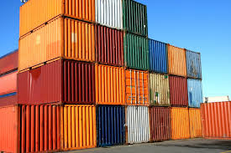
What is the nation-state container view of society?

Slide 27
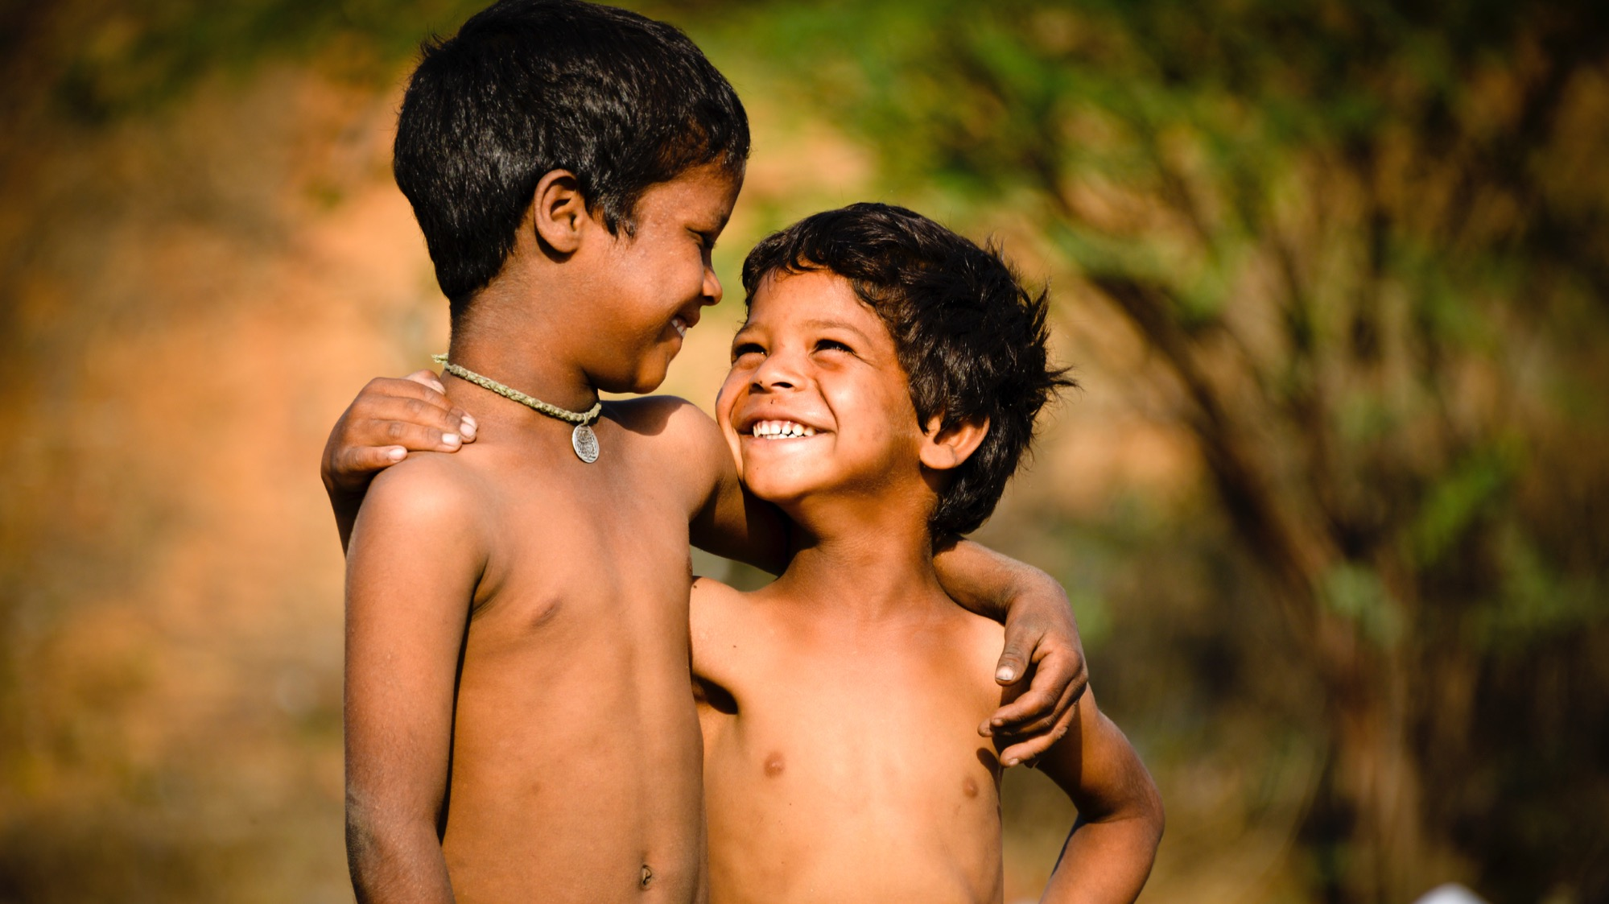
#1: End poverty in all its forms everywhere

Slide 28
Entertain and pace your presentation
Make your presentations entertaining (without being goofy). Even serious presentations are better with a pinch of humor (the occasion determines to what extent this is adequate).
When making your presentation, don’t spend too much time on the background. Many presentations loose precious time “setting the scene” and then don’t have enough time for the major finding/points.
Set your own timer when you present. You don’t want to get a surprising “1 min” left warning half way through your presentation (and disable the auto lock function of your phone).

Slide 29
Professionalize your slides
A lot of useful animation comes intuitive when you spend some time with ppt. But there are 2 ways of “kicking it up a notch”:
Watch YouTube tutorials on how to do more sophisticated animation.
Invest 10-20 USD into a set of professionally made PPTs.
(A few examples are in the Class Presentations folder).

Slide 30
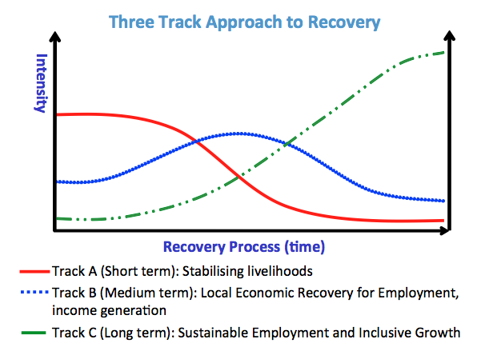
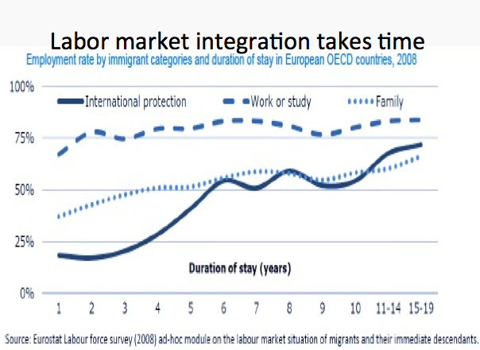
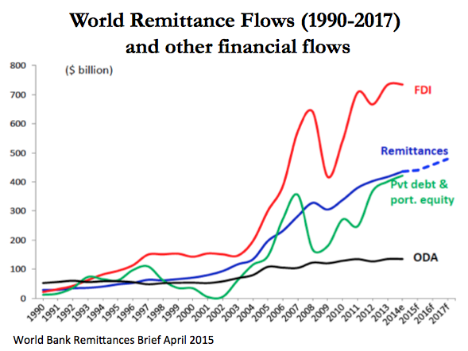
Other tips
You can prepare extra slides that you store after the “thank you slide”. If you get questions in the Q&A session you can refer to these additional data/charts.

Slide 31
Advice for group presentations
You may want to briefly introduce the team.
Some prefer explicit transitions (“Now Samira will introduce the …”). I think it’s better to just switch without much noise about it. But if you present the structure of your talk in the beginning you can say who will do what.
Even those not talking are “on stage”. Consider your body posture and presence.
Rehearse together and respect your time limit. Otherwise the last person gets no time to talk.

Slide 32
General advice on presenting
Avoid large, white, letter-sized notepads in your hands that distract.
You can have small notes or cue cards.
If you have many “notes”, you can make another PowerPoint presentation with them, print them with 2 or 3 slides on one page (hand-out format) and then cut out the “slides” into “talk show host cue cards”.
However the best presentations are delivered freely.

Slide 33
General advice on presenting
Move your head and look at all sides of the room to include everyone.
If you are presenting in front of a panel or your professor, as well as the class, don’t present only for the panel. Present to the entire audience, which happens to include the panel.
If you regularly give presentations I recommend you to get a wireless presenter (clicker). This makes presenting a lot easier.

Slide 34
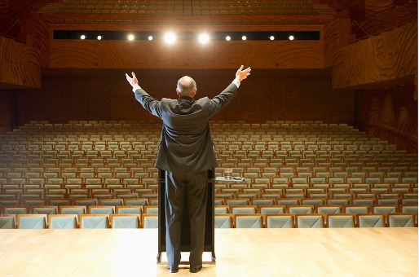
General advice on presenting
Only well-rehearsed presentations are good presentations.
Thus: Rehearse, rehearse, rehearse! This means practicing aloud (and ideally with a clicker).

Slide 35
Some sample slides
from my own presentations
(I recommend you start the slide show for these to see the animation that follows the flow of my argument)

Slide 36
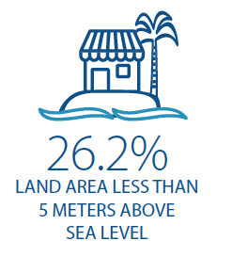
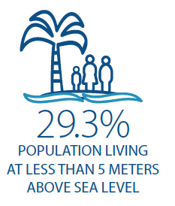
Internal and international migration will increase due to
population dynamics,
economic factors,
environmental factors, including sea-level rise
Facilitate and manage human mobility as an adaptation strategy
Adjust and diversify livelihood strategies
SIDS

Slide 37
Contri-butors
to SD
SD affects mobility
Migration as development
Emigration/Mobility
Emigrants & diaspora
leads
to
Emigration
contribute
Sustainable Development
Outcomes
affect
Immigrants
Immigration
Refugees
target
Displacement
Immigrants
Refugees
Emigrants & diaspora
Internally Displaced Persons
target and vulnerable populations for SD outcomes

Slide 38
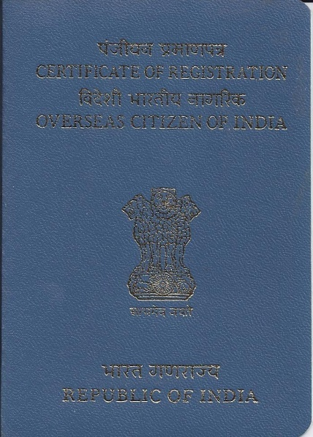
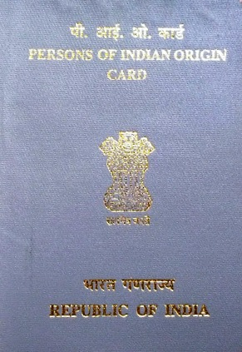
Introduction | Principal Effects | Action Effects | Conclusion OCI Focus Mig&Dev
?

Slide 39
Introduction | Principal Effects | Action Effects | Conclusion OCI Focus Mig&Dev
?
Overseas Citizenship
of India
Development
in India

Slide 40
Introduction | Principal Effects | Action Effects | Conclusion OCI Focus Mig&Dev
Opening the ‘black box’:
Exploring the effect of OCI on development
Overseas Citizenship
of India
Actions by the diasporic actors
Development
in India
How?
What?
How?
What?

Slide 41
Introduction | Principal Effects | Action Effects | Conclusion Summary | Issues & questions
Good-will effect
Adoption
of OCI status
Remitting, investing, trading, returning, lobbying,
etc.
All groups
Naturalization effect
OCI-induced
naturalizers
Ability
to act
Develop-ment in India
Availability
of OCI
Rights effect
Decision
for Old Cases,
Second-plus generation, Certain Naturalizers
Permissibility
Status passages toward OCI and
having OCI
Old Cases,
Second-plus generation,
Certain Naturalizers
Identity effect

Slide 42
Including populations not covered by social protection schemes
⓪①
⓪①
Nation
State
⓪①
How to close
protection & regulation gaps?
⓪①
Nation
State
⓪①
⓪①
Notes:
The yellow populations reside in one country (country of destination but it can also be the case of return mirgrants who returned to their country of origin) and are not covered by health insurance, pensions, etc.

Slide 43
Including populations not covered by social protection schemes
⓪①
⓪①
Country of
origin
solution
Nation
State
⓪①
⓪①
Nation
State
⓪①
⓪①
Notes:
One option is that the COO expands its policies to incorporate these populations through a transnationalization of their social protection policies.

Slide 44
Including populations not covered by social protection schemes
⓪①
⓪①
Nation
State
⓪①
⓪①
Country of
destination
solution
Nation
State
⓪①
⓪①
Notes:
UNCTs in countries of destination: Increase capabilities and social development outcomes
Migration and obtaining refuge can lead to enhanced education and health incomes for migrants. However, oftentimes migrants, refugees, and displaced persons have limited access to education and health systems, rendering them vulnerable and impeding sustainable development outcomes. Irregular migrants are particularly vulnerable since many of them are afraid to access services for fear of deportation. For this reason the 2030 Agenda for Sustainable Development stresses that people who are vulnerable, particularly refugees, IDPs and migrants, must be empowered (paragraph 23).
In the area of social security, receiving countries can enter into bilateral and multilateral agreements on social protection with countries of origin as described above and adopt unilateral measures for enhancing migrant workers’ access to social protection. In the absence of a bilateral social security agreement entered into by the Parties, unilateral measures from countries of employment are of particular importance. Those can include equality of treatment with the nationals of the receiving country enshrined in national social security legislation, as well as inclusion of provisions allowing for the payment of benefits abroad. Similarly, both labour and social security laws should apply regardless of the worker’s nationality. As such, their personal scope of application should be as broad as possible, so as to include traditionally excluded categories of workers.
Establish and maintain national Social Protection Floors (SDG 1.3) comprising basic social security guarantees to ensure at a minimum that, over the life cycle, all in need have access to essential health care and to basic income security. As per article 6 of the Social Protection Floors Recommendation, 2012 (No. 202), such guarantees should be provided to at least all residents and children, as defined in national laws and regulations and subject to a country’s existing international obligations. As such, migrants should have access to these basic social security guarantees in the State where they reside, as well as in their home country. Should there be legal provisions or bilateral or multilateral agreements in place providing for higher levels of protection, or should the countries concerned be parties to international or regional Conventions containing higher requirements with regards to migrants’ social security rights (e.g. ILO Convention No. 118 and No. 157) these should prevail.
The Universal Declaration on Human Rights (UDHR) and Art. 13 of the International Covenant on Economic, Social and Cultural Rights (ICESCR) state that States are under the obligation to respect the right to education and health by, inter alia, refraining from denying or limiting equal access for all persons, including asylum seekers and migrants in an irregular situation, to preventive, curative, rehabilitative, and palliative health services. All persons, irrespective of their nationality, residency or immigration status are entitled to primary and emergency health services. UNCTs should assess de facto and de iure impediments to the exercise of such rights for certain populations and promote the effective access to quality services in this regard.
Address legislative and policy frameworks that limit the rights of immigrants, IDPs, refugees, and asylum seekers to primary, secondary, tertiary, and vocational education. Implement programmes to disseminate information and to affect the social norms governing migrants’, refugees’, and IDPs’ access to quality education. This also relates to endeavours to ensure that all girls and boys complete free, equitable and quality primary and secondary education leading to relevant and effective learning outcomes (SDG target 4.1); ensure equal access for all women and men to affordable and quality technical, vocational and tertiary education, including university (SDG target 4.3); increase the number of youth and adults who have relevant skills, including technical and vocational skills, for employment, decent jobs and entrepreneurship (SDG target 4.4); and to eliminate gender disparities in education and ensure equal access to all levels of education and vocational training for the vulnerable, including persons with disabilities, indigenous peoples and children in vulnerable situations (SDG target 4.5).
Similarly, address regulatory and practical obstacles for male and female migrants, refugees, and IDPs to access national social protection floors, including safety nets, other social protection schemes, universal health coverage and access to quality essential health services (SDG target 3.8), as well as their universal and equitable access to safe and affordable drinking water for all (SDG target 6.1) universal access to affordable, reliable and modern energy services (SDG target 7.1). UNDAFs can include specific outcome indicators that assess the outcomes for refugees, IDPs, and other target populations, as does the UNDAF in the Central African Republic for maternal mortality, in Chad for sanitary and nutrition services, in Congo on social protection, in Egypt multi-dimensional child poverty among migrant, refugee, and asylum seeker children.
Large-scale influxes of migrants, refugees, and IDPs can constitute challenges for local authorities to provide quality public services for the overall populations, including health, education, and social welfare support. UNCTs can provide additional support to these localities to provide such services.
A range of social development policies and programmes can actively promote integration of immigrants, refugees, and IDPs, including through cultural and language trainings. Such activities can also seek to build social bridges between different population groups and between state institutions and immigrants, refugees, and IDPs. Economic integration might enrich the production diversity in the host country and give a cultural added value to some economic sectors. The artisanal products made by migrants and refugees are a great example of this.
UNCTs can work to promote tolerance and combat xenophobia and racial discrimination, including by highlighting the positive social, cultural and economic contributions of migrants and calling for zero tolerance of discrimination, racism and xenophobia.
UNDAFs can aim at strengthening social security for internal migrants, as does the framework in China that includes concrete activities on improving access to and quality of health services for migrant and ethnic minority groups.

Slide 45
Including populations not covered by social protection schemes
⓪①
⓪①
Nation
State
⓪①
Solution
involves
CoO & CoD
⓪①
Nation
State
⓪①
⓪①

Slide 46
Diaspora Engagement Schemes
Diaspora & Science
Diaspora & Heath care
Diaspora Investment
One-stop-shop
Diaspora Ministries/Institutions
Diaspora & Agriculture
Diaspora & Diplomacy
Diaspora & Entrepreneurship
Culture & Diaspora
Diaspora & Education
Diaspora&Knowledge transfer
Diaspora & Investment
Policy Implications
Institutional
Implications
Implications for Participation

Slide 47
Migration and Public Policies
Migration
Immigration
Emigration
Diaspora options
Return migration
Transit
Develop-ment
Remitting, investing, trading, returning, lobbying,
etc.
Policies & Programmes
Design
Implementation
M&E
Notes:
Mainstreaming migration is generally understood as the process for integrating migration issues in a balanced manner into the design, implementation, monitoring and evaluation of policies and programmes in any sphere related to development and poverty reduction (IOM 2010).
It is argued that the most appropriate way to ensure a systematic approach is to mainstream migration and development issues into country level planning frameworks (GMG 2010, p. 15). Thus, the inclusion of migration-related concepts in a country’s development plan, such as a Poverty Reduction Strategy Paper (PRSP) or any other plan is an activity to mainstream migration. Reviewing all national development plans and PRSPs adopted between 2000 and 2010, in an unpublished assessment, UNDP found 93 countries that had referred to migration in their strategies, mostly, however in a superficial way. While the role of remittances and engaging the diaspora is often acknowledged, the planned activities rarely consider how migration-related aspects can be considered strategically to foster economic and human development.
In this regard, Bosnia and Herzegovina has already done the first steps toward mainstreaming migration. For example, the Draft Strategy of Development of Bosnia and Herzegovina from May 2010—though not a final and approved document—is an example for how migration aspects have begun to being incorporated into the development plans. In the situation analysis, the importance of remittances for the improvement of the balance of payments and reduction of poverty is acknowledged and priority 2 that aims at the creation of conditions for increased savings and investments suggests to “create and improve conditions for activating the investment potentials and resources of the BH diaspora.” Priority 3 of the Draft Strategy is dedicated to making use of skills and knowledge of diaspora experts and scientists, by developing programs for their return, for circular migration and to create networks between the academic diaspora and BH institutions. Also the Strategy in the Area of Migrations and Asylum 2012-2015 includes a mid-term strategic goal on ‘strengthening institutional capacities in Bosnia and Herzegovina with the purpose of connecting migration and development.’
These and other policy documents show that Bosnia and Herzegovina has advanced the migration agenda in its policy documents much more than many countries. However, it appears that that there is room for a wider and more systematic approach of considering the migration and development nexus in the overall policy, planning and programme framework and to consider more specific migration questions.
More advanced levels of mainstreaming are characterized by (a) a more comprehensive process that leads to the inclusion in these planning documents and related to a number of diverse actors involved in the consideration; (b) more concrete policy and programme goals that are linked to other sectors and priorities. This will be discussed more in detail below. The major take-away point is that mainstreaming migration includes a continuum of options and activities with varying degrees of detail and depth. It will be the task of the Working Group and subsequent processes to determine the adequate level for the state, entity, canton and municipal level.

Slide 48
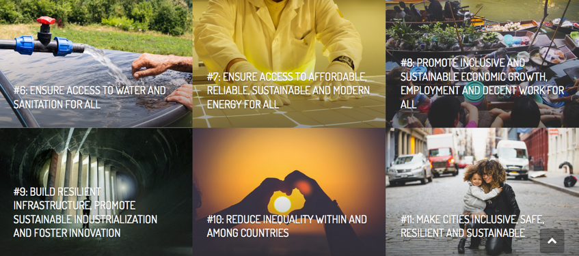
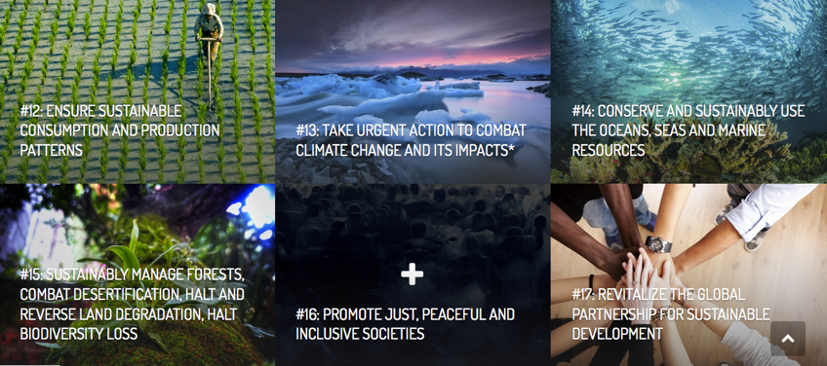
Each goal is
important
in itself …

Slide 49
Each goal is
important
in itself …
and they
are all
connected

Slide 50
3 levels of UN interventions
Root Causes and Drivers of Migration & Displacement
Managing Migration and Institutional Frameworks
Harnessing Migration for Development

Slide 51
3 levels of UN interventions
Employment (esp. youth employment)
Peace and Security
Environmental change
Governance and Rule of law
=> make migration a choice, not a necessity
Root Causes and Drivers of Migration & Displacement
Managing Migration and Institutional Frameworks
Harnessing Migration for Development

Slide 52
3 levels of UN interventions
Human Rights of Migrants and Refugees.
Fewer Migrant fatalities crossing (maritime) borders.
Increase avenues for legal migration.
Sound international/ bilateral/national policies.
Eliminate human trafficking
=> Making migration safe and well-managed
Root Causes and Drivers of Migration & Displacement
Managing Migration and Institutional Frameworks
Harnessing Migration for Development

Slide 53
3 levels of UN interventions
Reducing the cost of migration.
Reducing the cost of remittances.
Address brain drain.
Support return, diaspora investments, knowledge transfers.
=> Making migration work for sustainable development
Root Causes and Drivers of Migration & Displacement
Managing Migration and Institutional Frameworks
Harnessing Migration for Development

Slide 54
Unpacking the links between
migration and public policies
Migration & policies

Slide 55
Integrating human mobility
into public policies
Links between Migration, Displacement & Development
Migration & Displacement in UNDAFs
Migration & specific policy sectors
Policy & Institutional Coherence
Impact analysis

Slide 56
Migration and Displacement in UNDAFs
100%
EUROPE
97%
ASIA
81%
LATIN AMERICA & CARIBBEAN
100%
90%
OCEANIA
AFRICA
169

Slide 57
Migration and Public Policies
Economic Development
Employment
Environment & Climate Change
Education
SMEs & Industry
Migration & Displacement
Health
FDI
Good Governance
Rural Development
Agriculture
Notes:
Mainstreaming migration is generally understood as the process for integrating migration issues in a balanced manner into the design, implementation, monitoring and evaluation of policies and programmes in any sphere related to development and poverty reduction (IOM 2010).
It is argued that the most appropriate way to ensure a systematic approach is to mainstream migration and development issues into country level planning frameworks (GMG 2010, p. 15). Thus, the inclusion of migration-related concepts in a country’s development plan, such as a Poverty Reduction Strategy Paper (PRSP) or any other plan is an activity to mainstream migration. Reviewing all national development plans and PRSPs adopted between 2000 and 2010, in an unpublished assessment, UNDP found 93 countries that had referred to migration in their strategies, mostly, however in a superficial way. While the role of remittances and engaging the diaspora is often acknowledged, the planned activities rarely consider how migration-related aspects can be considered strategically to foster economic and human development.
In this regard, Bosnia and Herzegovina has already done the first steps toward mainstreaming migration. For example, the Draft Strategy of Development of Bosnia and Herzegovina from May 2010—though not a final and approved document—is an example for how migration aspects have begun to being incorporated into the development plans. In the situation analysis, the importance of remittances for the improvement of the balance of payments and reduction of poverty is acknowledged and priority 2 that aims at the creation of conditions for increased savings and investments suggests to “create and improve conditions for activating the investment potentials and resources of the BH diaspora.” Priority 3 of the Draft Strategy is dedicated to making use of skills and knowledge of diaspora experts and scientists, by developing programs for their return, for circular migration and to create networks between the academic diaspora and BH institutions. Also the Strategy in the Area of Migrations and Asylum 2012-2015 includes a mid-term strategic goal on ‘strengthening institutional capacities in Bosnia and Herzegovina with the purpose of connecting migration and development.’
These and other policy documents show that Bosnia and Herzegovina has advanced the migration agenda in its policy documents much more than many countries. However, it appears that that there is room for a wider and more systematic approach of considering the migration and development nexus in the overall policy, planning and programme framework and to consider more specific migration questions.
More advanced levels of mainstreaming are characterized by (a) a more comprehensive process that leads to the inclusion in these planning documents and related to a number of diverse actors involved in the consideration; (b) more concrete policy and programme goals that are linked to other sectors and priorities. This will be discussed more in detail below. The major take-away point is that mainstreaming migration includes a continuum of options and activities with varying degrees of detail and depth. It will be the task of the Working Group and subsequent processes to determine the adequate level for the state, entity, canton and municipal level.

Slide 58
Migration Policies
Who and how many enter (immigration) or leave the country (emigration).
Asylum policies.
Development-sensitive Migration Policies

Slide 59
Migration-sensitive activities
In addition to fiscal, admin., econ., social, environment impact:
Initiatives ➔ migration?
Migration ➔ initiative?
Unforeseen/unintended effect for im/emigration, return, refugees or IDPs?
Future im/emigration = threat to policy?
➔ choose different policy option or modify options.
Migration-targeted public policies
Development-sensitive Migration Policies
Migration-sensitive public policies

Slide 60
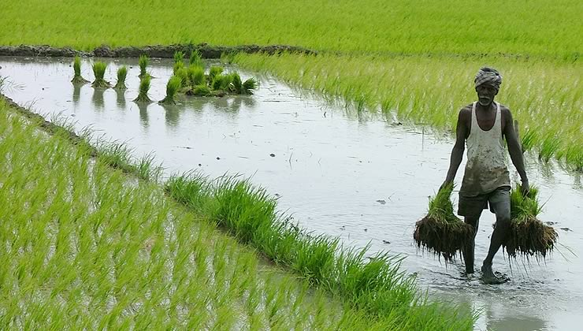
Migration & Agriculture
Agricultural jobs and services to address rural-urban/emigration
Skills training and tools for returnees, refugees, IDPs (Sudan)
Immigration/circular migration linked to agricultural needs
Diaspora savings, remittances, investments into agricultural production
(Ethiopia, Nepal, Philippines, Tunisia)
Diaspora knowledge for agro-processing, market access for agro-trade & supply chains

Slide 61
Diaspora Investment Policies
46 countries ≥ 1 policy measure to induce diaspora investments
tax exceptions or breaks
reduction of tariffs on goods or import duties
preferential treatment for credit
preferential treatment for licenses
streamlined bureaucratic process
diaspora bond
(United Nations 2013)
Latin America & Caribbean
Africa
65
%
Other Regions
>50
%
<33
%

Slide 62
From Policy to Impact
Policy
Outputs
Impacts
Theory of Change
How do
migration-targeted and migration-sensitive policies produce outcomes & impacts?

Slide 63
Being economically active, self-sustain,
etc.
Remitting, investing, trading, returning, lobbying,
etc.
Vector #
of migrants
Migrants’ capacity
Empowerment
Networks
Ability
to act
Development
Trust building
Opportunities
Information
Decision
Legal&regulatory framework
Information on it
Permissibility
Entry points for Public Policies
Determinants of migrants’ engagement
Intended Impacts
(Daniel Naujoks. 2013. Migration, Citizenship, and Development. OUP)
Notes:
One punch line

Slide 64
Thank you
for your attention
EMAIL @danaujoks

